Slide 1
Agile Project Management - Final Project
Msmsd 5213

Slide 2

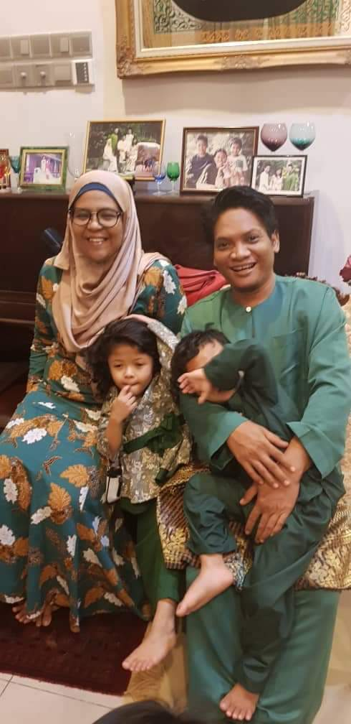
Team Member
UMMI IZZATI BINTI MUSTAPHA
MASTER OF SOFTWARE ENGINEERING (MOBILE DEVELOPMENT)
NIK INTAN HAZURA BINTI N ABDUL HALIM
MASTER OF SOFTWARE ENGINEERING (MOBILE DEVELOPMENT)

Slide 3
MSMD 5213 : Agile Project Management
Project Name
How tools contribute toward Agile Project Management
Scope
To share the experience of using Agile methodology via a short video.
Proposal
Using GitHub Project as tools
All project task and documentation recorded and added in tools
Benefits
Effective handling for project and releases
Well organized project and implementation
Familiarization to GitHub

